Slide 1



Applied data storytelling techniques in power bi
Anders Mayland Larsen
Data Analyst @ Pandora
Behavioral Economist

Slide 2















Slide 3
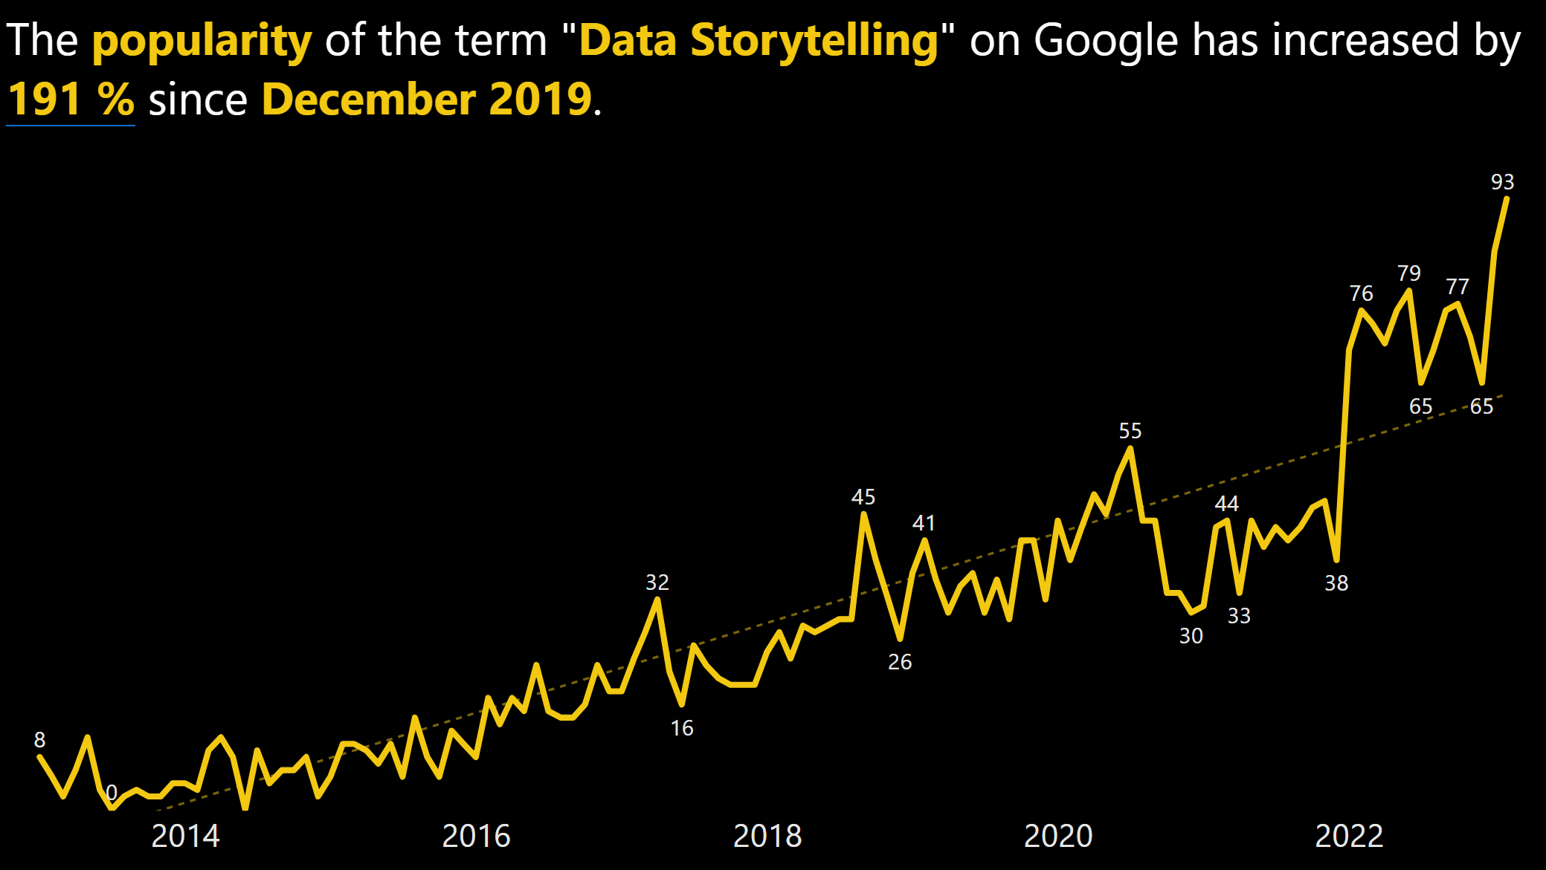
Notes:
When I first heard the term ”Data Storytelling” around 3 years ago, I didn’t think much of it. I thought it was just another data buzz-term being thrown around LinkedIn. In my mind, I pictured a group of cavemen-like data professionals gathering around a bonfire. The “Data Shaman” would feed the fire with slow DAX measures and ugly reports whilst telling stories about how he once created an amazing Power BI dashboard, only to have his boss say, “that’s really nice, but how do I export to Excel?”.
So, if data storytelling doesn’t include bonfires and data shamans, what is it then?

Slide 4
Data Storytelling Definition
“Data storytelling is the concept of building a compelling narrative based on complex data and analytics that help tell your story and influence and inform a particular audience.”
Source: https://powerbi.microsoft.com/en-us/data-storytelling/
Notes:
Microsoft’s definition is as follows: “Data storytelling is the concept of building a compelling narrative based on complex data and analytics that help tell your story and influence and inform a particular audience”. I would like to make this definition a bit clearer:

Slide 5
Data Storytelling Definition #2
“Data storytelling is the concept of building a compelling narrative based on complex data and analytics that informs communicates insights to a particular audience.”
Notes:
“Data storytelling is the concept of building a compelling narrative based on complex data and analytics that communicates insights to a particular audience.” Of course, everyone would like to see a compelling narrative over a not so compelling one, but a cake is still a cake, even if it tastes bad. Also, the used data does not need to be complex in order to create a narrative to support your findings. Lastly, informing someone is just passing along information. With data storytelling, we want to communicate our findings, meaning that we make sure our audience understands what we are saying and not just hear the information we are passing along.

Slide 6
Data Storytelling Definition #2
“Data storytelling is the concept of building a narrative based on data that communicates insights to a particular audience.”
Notes:
As human beings, we are terrible at remembering and internalizing statistics.

Slide 7


Han Solo & C-3PO
C-3PO
Han Solo

Slide 8

Notes:
How many in here have watched Star Wars? In Star Wars Episode V: The Empire Strikes Back, Han Solo and the crew are being chased by Imperial Tie Fighters. Han makes the bold move to fly directly into an asteroid field in hopes of evading the Empire. Luckily, we have C-3PO to share some statistics with the rest.

Slide 9
Sir, the possibility of successfully navigating an asteroid field is approximately 3,720 to 1!
Notes:
He says “Sir, the possibility of successfully navigating an asteroid field is approximately 3,720 to 1!” And what does Han Solo say:

Slide 10
That was a compelling statistic, C-3PO. I will find another course of action.
Notes:
“That was a compelling statistic. I will find another course of action.” No, he coldly states

Slide 11
Never tell me the odds!
Notes:
“Never tell me the odds.”
Who in here have found themselves in C-3PO’s situation, having shared what you believed to be a valuable insight only to be utterly dismissed? I know that I have.

Slide 12
Where did C-3PO fail?
C-3PO
Notes:
But why did C-3PO fail to influence Han?

Slide 13
Where did C-3PO fail?
Cherry-picking Insights
C-3PO
Notes:
First, C-3PO cherry-picked his insight and Han knew that. Han made the choice between certain death, staying and fighting the Imperials, or a high likelihood of death, by entering the asteroid field.

Slide 14
Where did C-3PO fail?
Cherry-picking Insights
Biased data
C-3PO
Notes:
Han also knew that the dataset C-3PO used to produce this probability estimate likely did not consist of pilots with his caliber. He was the captain of the fastest ship in the galaxy, after all.

Slide 15
Where did C-3PO fail?
Cherry-picking Insights
Biased data
Lack of narrative
C-3PO
Notes:
C-3PO lacked a narrative. Perhaps his insight would have been better had he told Han that, if they enter this asteroid field, they will likely never come out alive.

Slide 16
Where did C-3PO fail?
Cherry-picking Insights
Biased data
Lack of narrative
Lack of visual anchor
C-3PO
Notes:
Lastly, C-3PO communicated his statistic only through speech and therefore did not catch Han’s attention because he did not present a visual anchor.

Slide 17
Where did C-3PO fail?
Cherry-picking Insights
Biased data
Lack of narrative
Lack of visual anchor
C-3PO

Slide 18


Many forms of data communication fail
Reports
Dashboards
PowerPoints
Etc.
Notes:
C-3PO is not the only one who suffers from bad data communication practices. In my daily work life, I see reports, dashboards, PowerPoints etc. that all suffer the same fate as C-3PO; they do not enable change. This is an example from Microsoft, a Retail Analysis Example, and now, I know this is supposed to be an exploratory example, but I think we can do better, remove clutter, focus attention through smarter use of color, explain what the different visuals try to convey. Many forms of data communication rely too heavily on the facts and numbers to speak for themselves. But again, we as humans are not wired to act on facts. Whether we like it or not, we often act on emotion

Slide 19
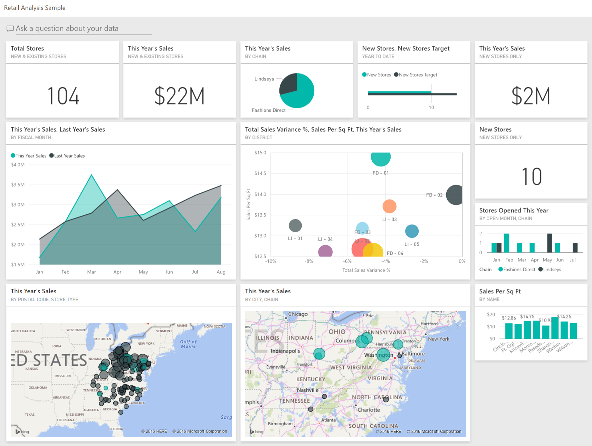

Slide 20
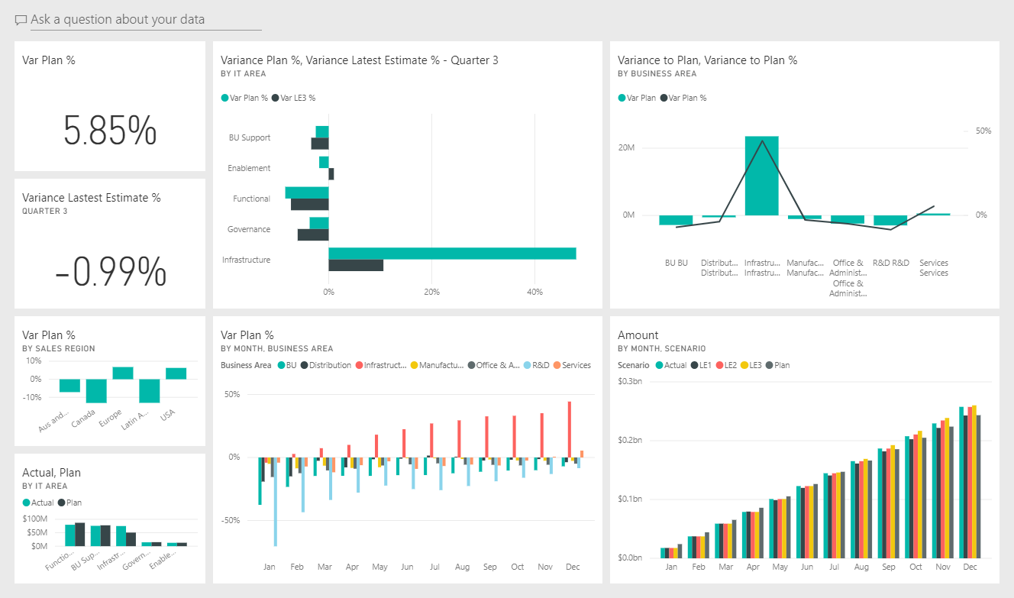

Slide 21

Two key factors in decision making
Luke
Notes:
Luke Skywalker is the hero of the Star Wars original trilogy. Like all fairy tales, he encounters the wise old man, the wizard, the mentor, Obi-Wan Kenobi.

Slide 22

Two key factors in decision making
Obi-Wan
Luke
Notes:
Throughout the story, Obi-Wan attempts to convince Luke that he must face and defeat the evil Darth Vader, spoiler alert, who is Luke’s father.

Slide 23

Two key factors in decision making
Logic
Obi-Wan
Luke
Notes:
It seems the logical thing to do; Darth Vader brings pain and suffering to the galactic population. The world would be a better place without him, no doubt. However, as one of the few movies to successfully do so, Luke does not defeat the evil villain. He turns him to the light side. Luke is not swayed by logic.

Slide 24

Two key factors in decision making
Logic
Obi-Wan
Luke
Leia
Notes:
He is swayed by emotion, in this case, the love for his father and his sister. He had found himself in a situation before, where Obi-Wan had tried to convince him to train his Jedi skills more, before facing Vader and had he followed that instruction, his friends would have died on Bespin.

Slide 25

Two key factors in decision making
Logic
Emotion
Obi-Wan
Luke
Leia
Notes:
But he acted on his compassion, and it saved his friends and redeemed his father. We may think that we are better and act more rationally than Luke Skywalker, but we don’t.

Slide 26
Disruptive insights
Notes:
Let me give you an example:

Slide 27

Disruptive insights
Notes:
If you, like me, step on the scale some mornings to weigh yourself, you will smile and go about your day, if the weight is unchanged or even better, if it has dropped.

Slide 28

Disruptive insights

Slide 29

Disruptive insights
Notes:
However, if you step on that scale and it shows that you have gained weight, you frown and question the accuracy of the scale. You get down and get on the scale a couple of times to validate the measurement. Why?

Slide 30



Disruptive insights
Notes:
Because the insight challenged your current perception of reality and based on that, you acted on negative emotion and weighed yourself multiple times with the same result. I think that may actually be an example of insanity.

Slide 31
Misuse of the term “Data Storytelling”
Data storytelling is a tool like any other.
Notes:
As human beings, we are terrible at remembering and internalizing statistics.

Slide 32
The “Story Zone”

Slide 33
The “Story Zone”
Low
High
Potential Value
Source: Brent Dykes (2019)

Slide 34
The “Story Zone”
Hard
Insight Type
Easy
Low
High
Potential Value
Source: Brent Dykes (2019)

Slide 35
The “Story Zone”
Hard
Insight Type
Agreeable
Conventional
Expected
Simple
Safe
Inexpensive
Intuitive
Easy
Low
High
Potential Value
Source: Brent Dykes (2019)

Slide 36
The “Story Zone”
Hard
Insight Type
Agreeable
Conventional
Expected
Simple
Safe
Inexpensive
Intuitive
Easy wins
Easy
Low
High
Potential Value
Source: Brent Dykes (2019)

Slide 37
The “Story Zone”
Unpleasant
Disruptive
Unexpected
Complex
Risky
Costly
Counterintuitive
Hard
Insight Type
Agreeable
Conventional
Expected
Simple
Safe
Inexpensive
Intuitive
Easy wins
Easy
Low
High
Potential Value
Source: Brent Dykes (2019)

Slide 38
The “Story Zone”
Unpleasant
Disruptive
Unexpected
Complex
Risky
Costly
Counterintuitive
Hard
Story Zone
Insight Type
Agreeable
Conventional
Expected
Simple
Safe
Inexpensive
Intuitive
Easy wins
Easy
Low
High
Potential Value
Source: Brent Dykes (2019)

Slide 39
Historical insights fit for a data story

Slide 40
Historical insights fit for a data story
Disease comes from microorganisms and you can kill them with disinfectant! (Louis Pasteur, Pasteurization)

Slide 41
Historical insights fit for a data story
Disease comes from microorganisms and you can kill them with disinfectant! (Louis Pasteur, Pasteurization)
The Sun is actually in the center of our Solar System! (Nicholas Copernicus, The Copernicum System)

Slide 42
Historical insights fit for a data story
Disease comes from microorganisms and you can kill them with disinfectant! (Louis Pasteur, Pasteurization)
The Sun is actually in the center of our Solar System! (Nicholas Copernicus, The Copernicum System)
If a wire carries an electric current next to a single magnetic pole, the wire will rotate! (Michael Faraday, Electricity)

Slide 43
Historical insights fit for a data story
Disease comes from microorganisms and you can kill them with disinfectant! (Louis Pasteur, Pasteurization)
The Sun is actually in the center of our Solar System! (Nicholas Copernicus, The Copernicum System)
If a wire carries an electric current next to a single magnetic pole, the wire will rotate! (Michael Faraday, Electricity)

Slide 44
The Three Elements of a Data Story

Slide 45

The Three Elements of a Data Story
Data

Slide 46


The Three Elements of a Data Story
Visuals

Slide 47
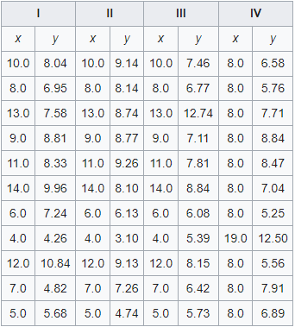
Ancombe’s Quartet
Source: https://en.wikipedia.org/wiki/Anscombe's_quartet

Slide 48
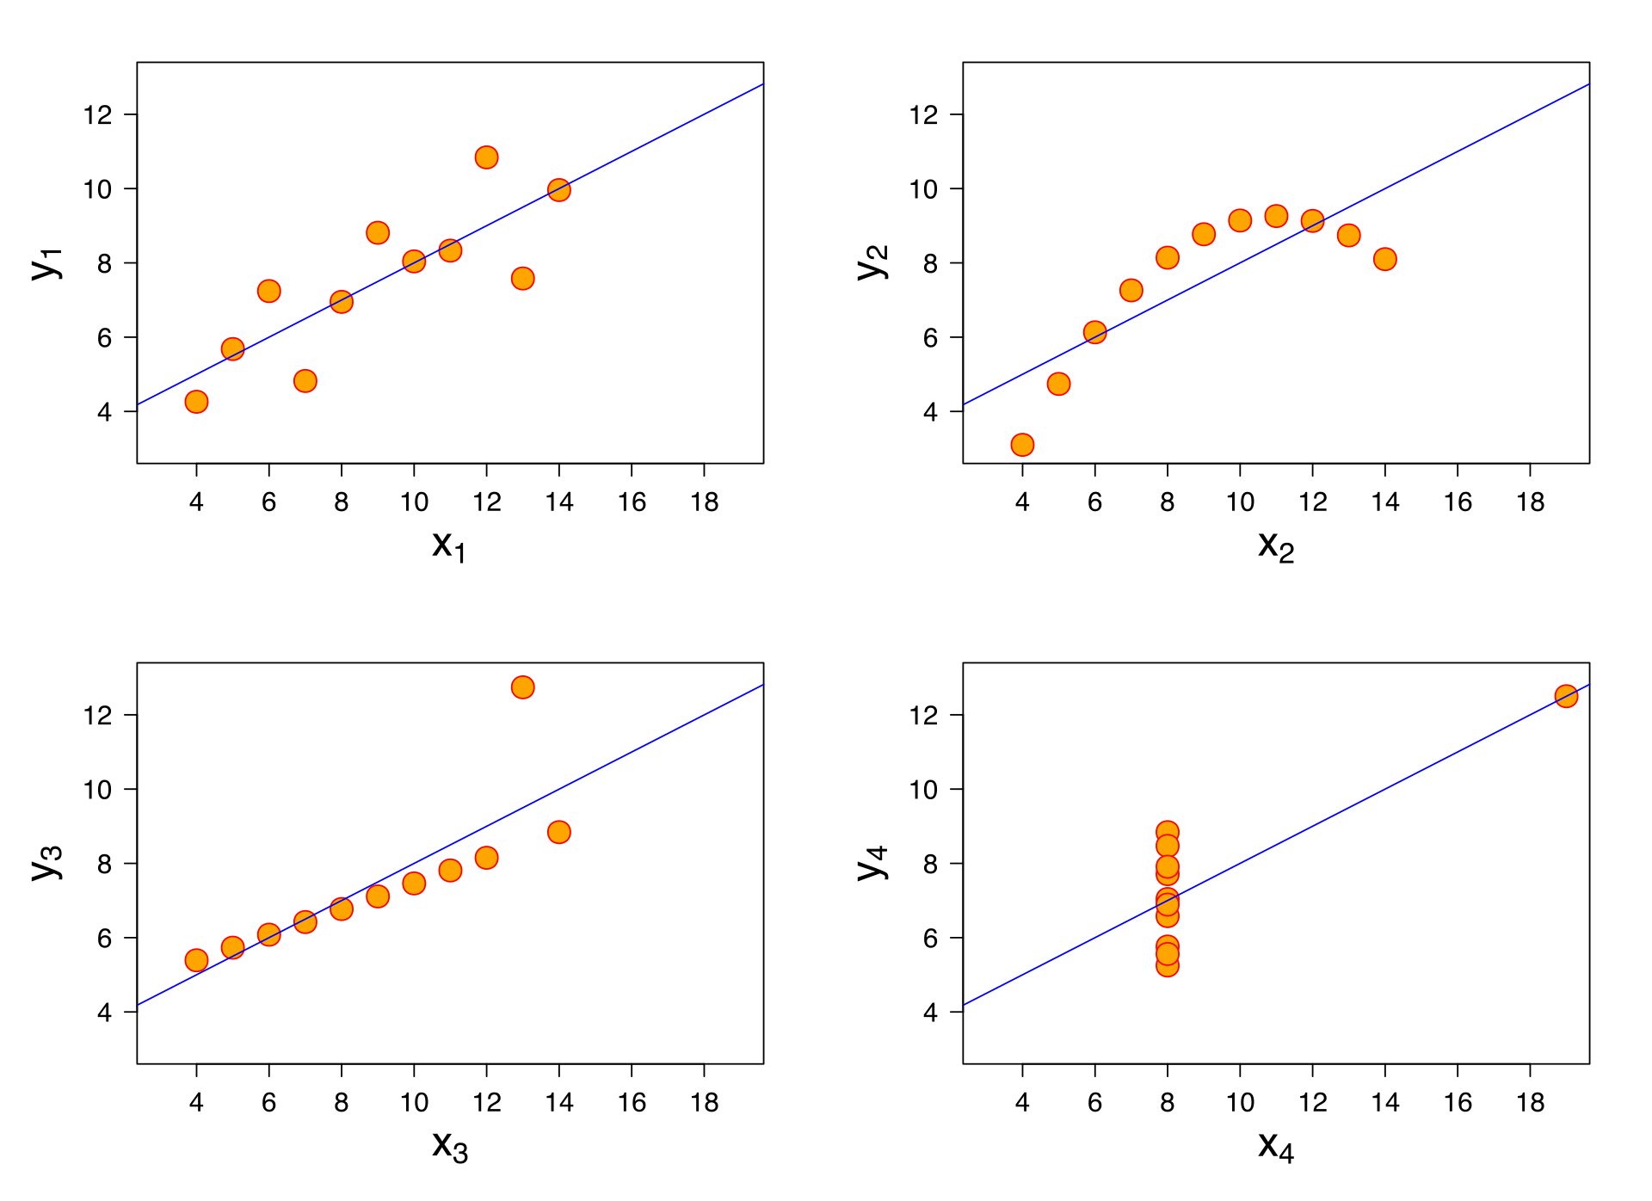
Ancombe’s Quartet
Source: https://en.wikipedia.org/wiki/Anscombe's_quartet

Slide 49
The Three Elements of a Data Story
Visuals

Slide 50


The Three Elements of a Data Story
Narrative

Slide 51
The Three Elements of a Data Story
Data
Visuals
Narrative

Slide 52
The Three Elements of a Data Story
Narrative
Explain
Engage
CHANGE
Data
Visuals
Enlighten

Slide 53
Data Storytelling Arc

Slide 54
Data Storytelling Arc
1 Setting
Source: Brent Dykes (2019)

Slide 55

Data Storytelling Arc
1 Setting
Source: Brent Dykes (2019)

Slide 56


Data Storytelling Arc
2 Rising Inisghts
1 Setting
Source: Brent Dykes (2019)

Slide 57


Data Storytelling Arc
3 Aha Moment
2 Rising Inisghts
1 Setting
Source: Brent Dykes (2019)

Slide 58


Data Storytelling Arc
3 Aha Moment
4 Solution & Next Steps
2 Rising Inisghts
1 Setting
Source: Brent Dykes (2019)

Slide 59

Data Storytelling Arc
3 Aha Moment
4 Solution & Next Steps
2 Rising Inisghts
1 Setting
Audience’s knowledge is enriched and likelihood to act is increased
Source: Brent Dykes (2019)

Slide 60
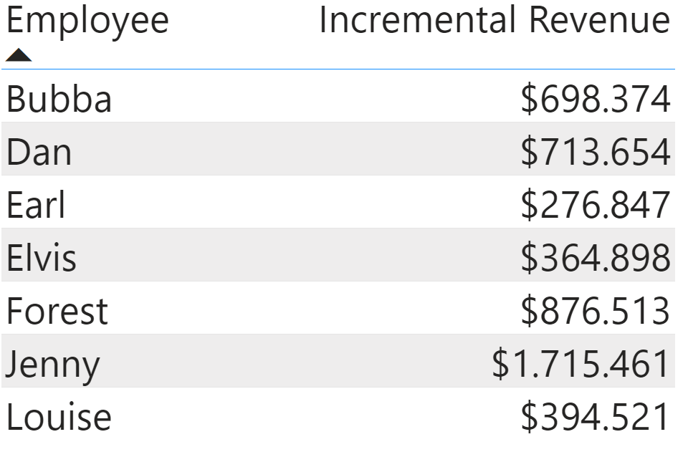
Data
Notes:
Let’s take a short example of using first only data, then adding visuals, and finally, adding a narrative to the mix, along with keeping our story arc in mind. Imagine you are a manager for a sales division. You learn that one of your top-performing employees, Jenny, has received a job offer from a competitor, with a prospect of a significant pay increase. You know Jenny does great work, and without her, you won’t reach your sales targets. You must request a pay raise for Jenny from the sales director. I will show a couple of slides in silence, and then I will add some narration at the end. So, here we go:
[Show table with the raw data (maybe summarized)]
[Show nice data visualization using the same numbers]
[Tell engaging story]
Now, you go to the Sales Director, or perhaps just throw them an email. You start by setting the scene, telling them how Jenny is a top-performer and a great salesperson. Then, you hook the sales director, by sharing how she has received a job offer from a competitor, which will significantly increase her salary. You add the “Aha” moment, by showing the data visual you created, that shows how much incremental revenue Jenny brings to the team. You propose a solution, in this case perhaps matching or outbidding the salary increase proposed by the competitor, if applicable. In this case, I skipped the rising insights because I hoped, as the sales manager, that the decision to increase Jenny’s pay is a no-brainer for the sales director. However, if this was not a no-brainer and the sales director would have wanted to dig deeper into the revenue calculations, then a complete data story, including rising insights would have been better. You can use this storytelling arc however you want.
Delete. Not personally relevant example and adds more time for demonstration

Slide 61
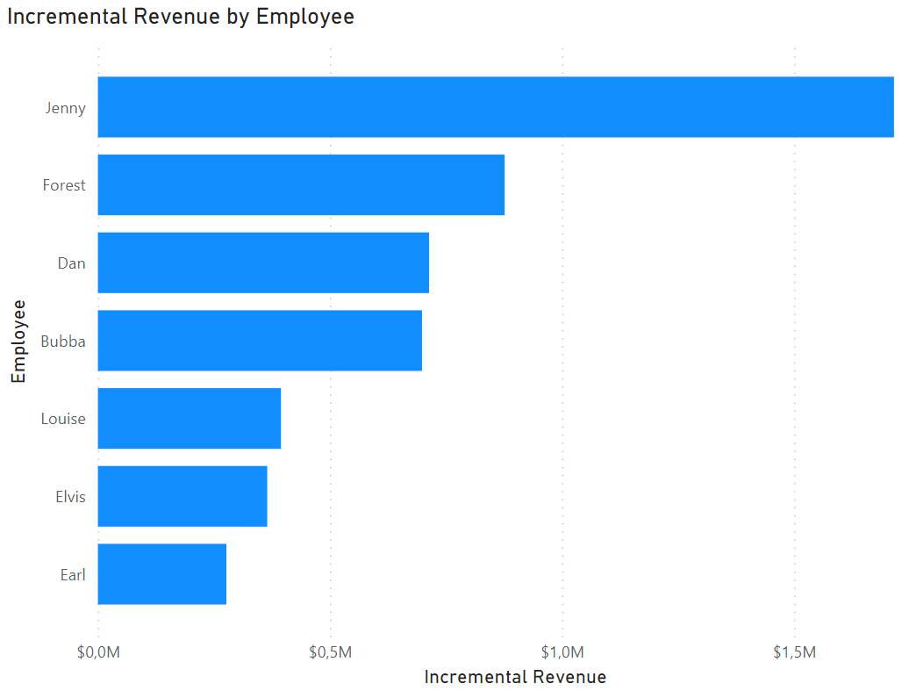
Visual

Slide 62
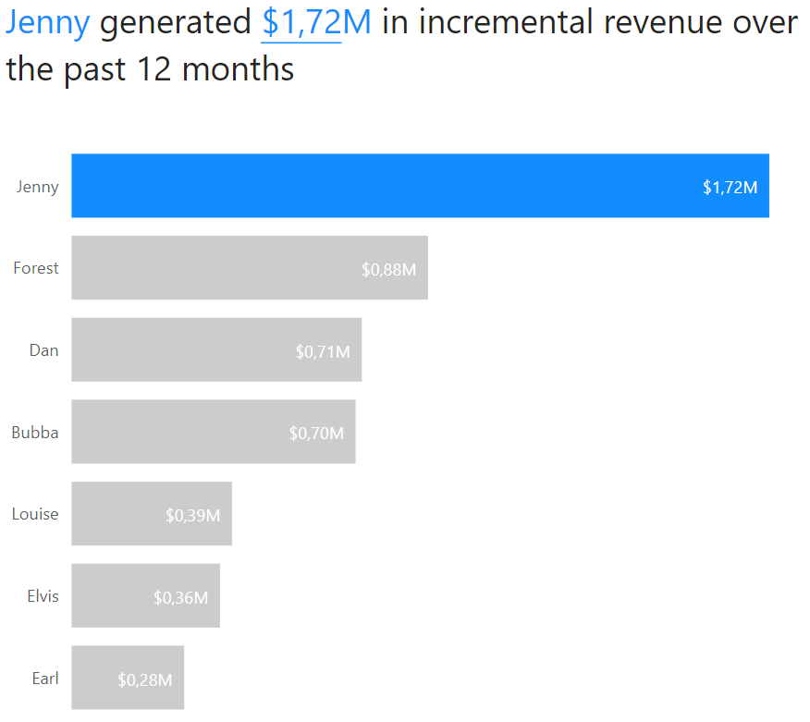
Narrative

Slide 63
6 Essential Data Storytelling Components

Slide 64



6 Essential Data Storytelling Components
Data Foundation | Main Point | Explanatory Focus | Linear Sequence | Dramatic Elements | Visual Anchors
Source: Brent Dykes (2019)

Slide 65
6 Essential Data Storytelling Components
 | Data Foundation | Main Point | Explanatory Focus | Linear Sequence | Dramatic Elements | Visual Anchors
Data Presentations | Yes | Maybe | Often | Often | Maybe | Yes
Curated Reports | Yes | Maybe | Often | Maybe | Maybe | Yes
Infographics | Yes | Maybe | Maybe | Maybe | Maybe | Yes
Data Visualizations | Yes | Maybe | Maybe | Maybe | Maybe | Yes
Automated Reports | Yes | No | No | No | No | Yes
Alerts | Yes | Yes | No | No | No | Maybe
Source: Brent Dykes (2019)

Slide 66
6 Essential Data Storytelling Components
 | Data Foundation | Main Point | Explanatory Focus | Linear Sequence | Dramatic Elements | Visual Anchors
Data Presentations | Yes | Maybe | Often | Often | Maybe | Yes
Curated Reports | Yes | Maybe | Often | Maybe | Maybe | Yes
Infographics | Yes | Maybe | Maybe | Maybe | Maybe | Yes
Data Visualizations | Yes | Maybe | Maybe | Maybe | Maybe | Yes
Automated Reports | Yes | No | No | No | No | Yes
Alerts | Yes | Yes | No | No | No | Maybe
Source: Brent Dykes (2019)

Slide 67
6 Essential Data Storytelling Components
 | Data Foundation | Main Point | Explanatory Focus | Linear Sequence | Dramatic Elements | Visual Anchors
Data Presentations | Yes | Maybe | Often | Often | Maybe | Yes
Curated Reports | Yes | Maybe | Often | Maybe | Maybe | Yes
Infographics | Yes | Maybe | Maybe | Maybe | Maybe | Yes
Data Visualizations | Yes | Maybe | Maybe | Maybe | Maybe | Yes
Automated Reports | Yes | Maybe | No | No | No | Yes
Alerts | Yes | Yes | No | No | No | Maybe

Slide 68
6 Essential Data Storytelling Components
 | Data Foundation | Main Point | Explanatory Focus | Linear Sequence | Dramatic Elements | Visual Anchors
Data Presentations | Yes | Maybe | Often | Often | Maybe | Yes
Curated Reports | Yes | Maybe | Often | Maybe | Maybe | Yes
Infographics | Yes | Maybe | Maybe | Maybe | Maybe | Yes
Data Visualizations | Yes | Maybe | Maybe | Maybe | Maybe | Yes
Automated Reports | Yes | Maybe | Maybe | No | No | Yes
Alerts | Yes | Yes | No | No | No | Maybe

Slide 69
6 Essential Data Storytelling Components
 | Data Foundation | Main Point | Explanatory Focus | Linear Sequence | Dramatic Elements | Visual Anchors
Data Presentations | Yes | Maybe | Often | Often | Maybe | Yes
Curated Reports | Yes | Maybe | Often | Maybe | Maybe | Yes
Infographics | Yes | Maybe | Maybe | Maybe | Maybe | Yes
Data Visualizations | Yes | Maybe | Maybe | Maybe | Maybe | Yes
Automated Reports | Yes | Maybe | Maybe | Maybe | No | Yes
Alerts | Yes | Yes | No | No | No | Maybe

Slide 70
6 Essential Data Storytelling Components
 | Data Foundation | Main Point | Explanatory Focus | Linear Sequence | Dramatic Elements | Visual Anchors
Data Presentations | Yes | Maybe | Often | Often | Maybe | Yes
Curated Reports | Yes | Maybe | Often | Maybe | Maybe | Yes
Infographics | Yes | Maybe | Maybe | Maybe | Maybe | Yes
Data Visualizations | Yes | Maybe | Maybe | Maybe | Maybe | Yes
Automated Reports | Yes | Maybe | Maybe | Maybe | Maybe | Yes
Alerts | Yes | Yes | No | No | No | Maybe

Slide 71
DEMO
Notes:
As human beings, we are terrible at remembering and internalizing statistics.

Slide 72
Summary

Slide 73
Summary
Defined Data Storytelling

Slide 74
Summary
Defined Data Storytelling
What problems Data Storytelling helps solve

Slide 75
Summary
Defined Data Storytelling
What problems Data Storytelling helps solve
When to tell data stories and when not to

Slide 76
Summary
Defined Data Storytelling
What problems Data Storytelling helps solve
When to tell data stories and when not to
Constituents of a data story (3 elements and 6 components)

Slide 77
Summary
Defined Data Storytelling
What problems Data Storytelling helps solve
When to tell data stories and when not to
Constituents of a data story (3 elements and 6 components)
How we can use some of these techniques in Power BI

Slide 78
Summary
Defined Data Storytelling
What problems Data Storytelling helps solve
When to tell data stories and when not to
Constituents of a data story (3 elements and 6 components)
How we can use some of these techniques in Power BI

Slide 79
Thank you!
Any questions?
Notes:
As human beings, we are terrible at remembering and internalizing statistics.

Slide 80






Data Analytics Marathon

Slide 81


Data Analytics Marathon

Slide 82
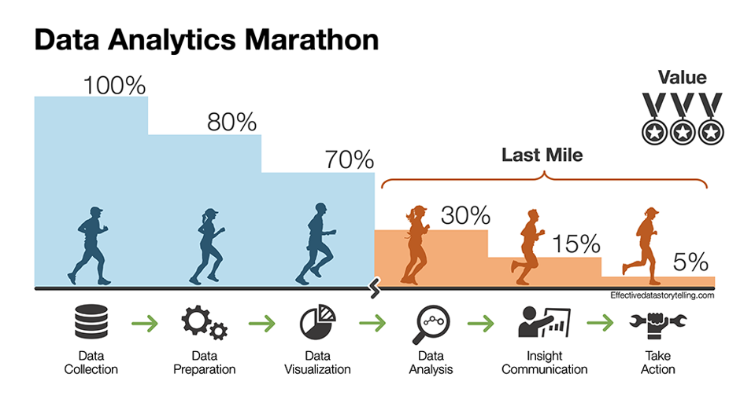




Data Analytics Marathon

